Slide 1
Understanding Voter Knowledge and Party Affiliation of UNC Students
Elvis Atitsoabui, Sloan Duvall, Jennings Dean, Matthew Li, Jaci Crute

Slide 2
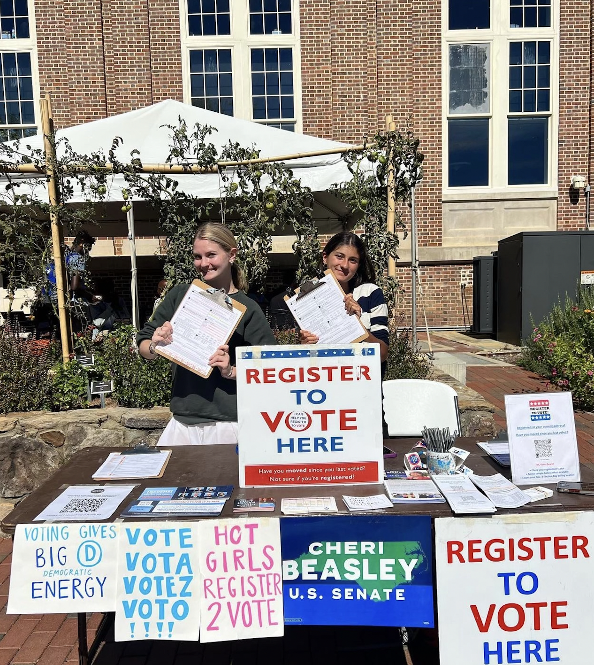
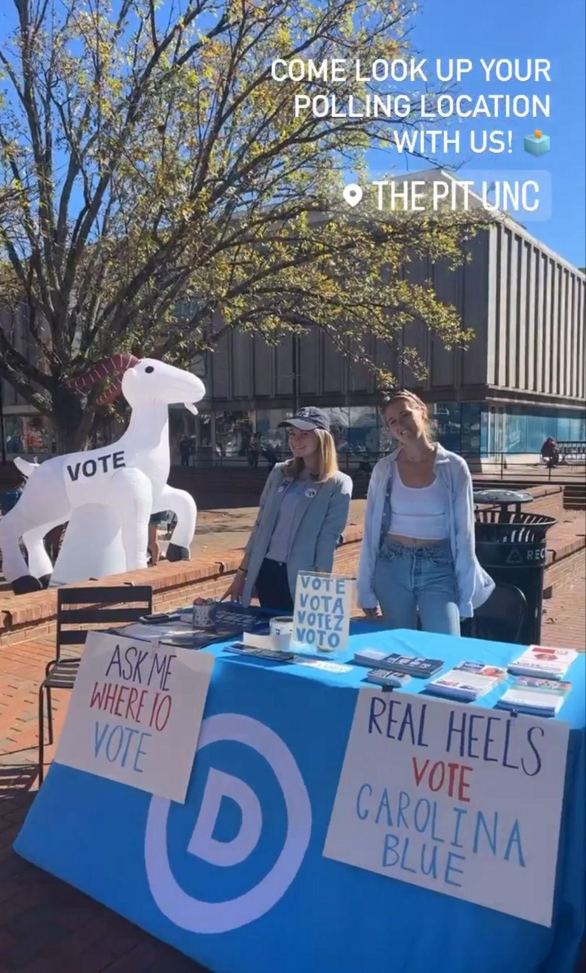

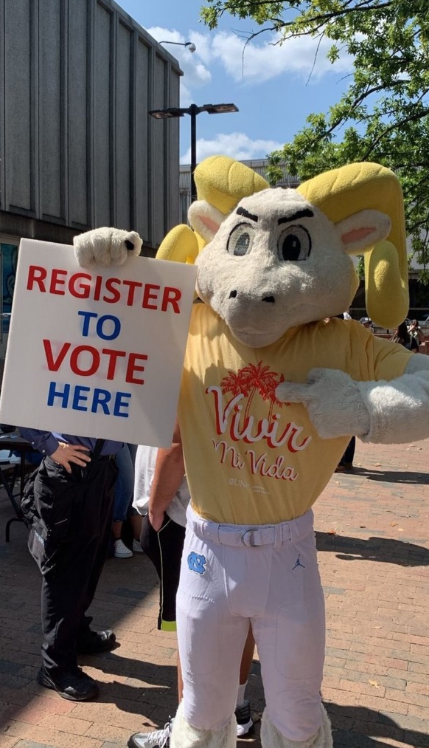
Background

Slide 3
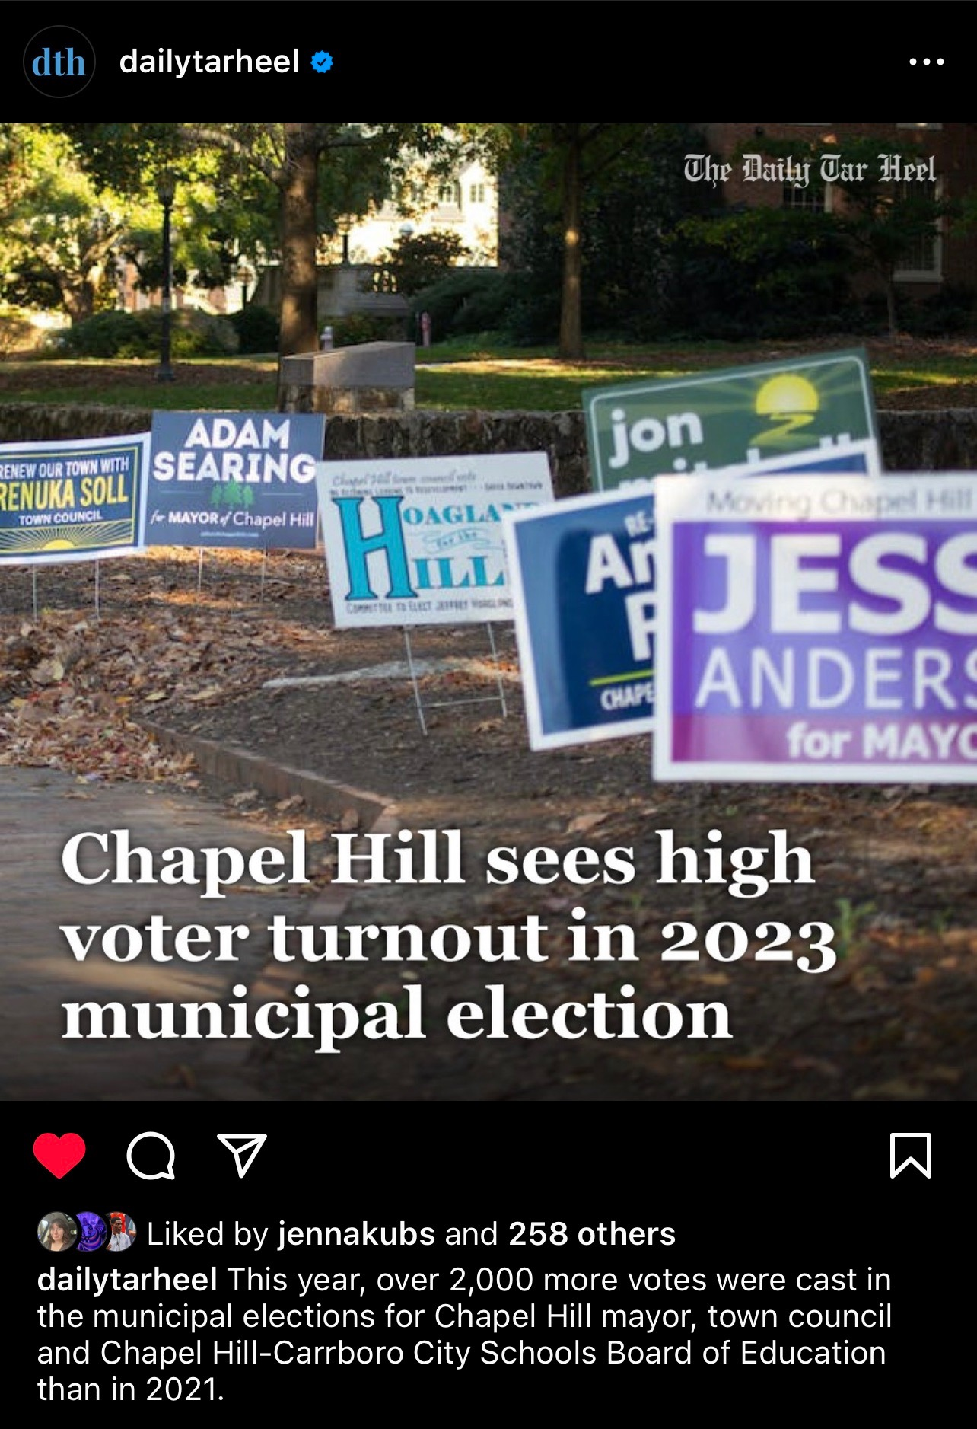

Slide 4
Theory
How does undergraduate (primary) major relate to party identification and election knowledge?
STEM major students usually have less political knowledge and are more conservative leaning than non-STEM majors.
Humanities majors are more likely to learn more about politics, American culture, and societal issues which leads them to support more liberal policies.
STEM majors focus more on math and science preventing them from engaging in deep discussions on politics which leads them to support more conservative policies.

Slide 5
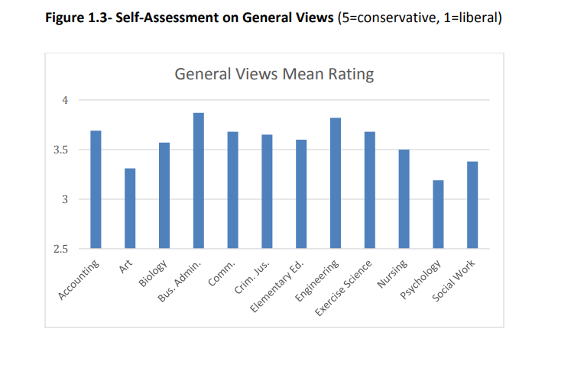
Theory Evidence
College students were asked in an online survey from Olivet Nazarene University about their major and how conservative or liberal their general views are from 1 being liberal and 5 being conservative.
Accounting = 3.69; Biology = 3.47; Business = 3.87
Art = 3.31; Social work = 3.38; Psychology = 3.19

Slide 6
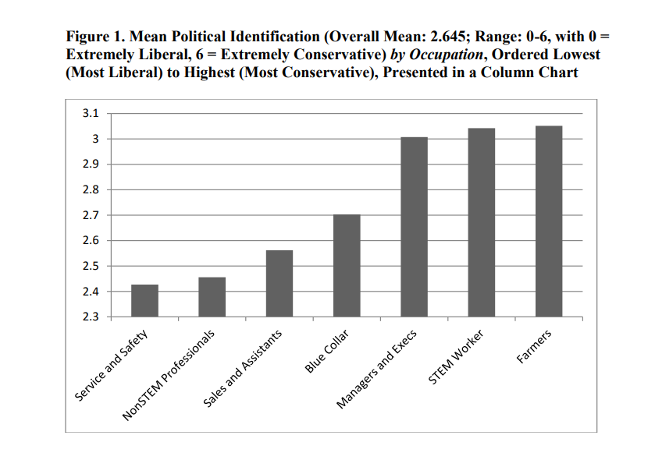
Theory Evidence
Political identification of STEM workers and other professionals within the workforce. 1 being extremely liberal to 6 being extremely conservative.
STEM = 3.042
Non-STEM professionals = 2.456

Slide 7
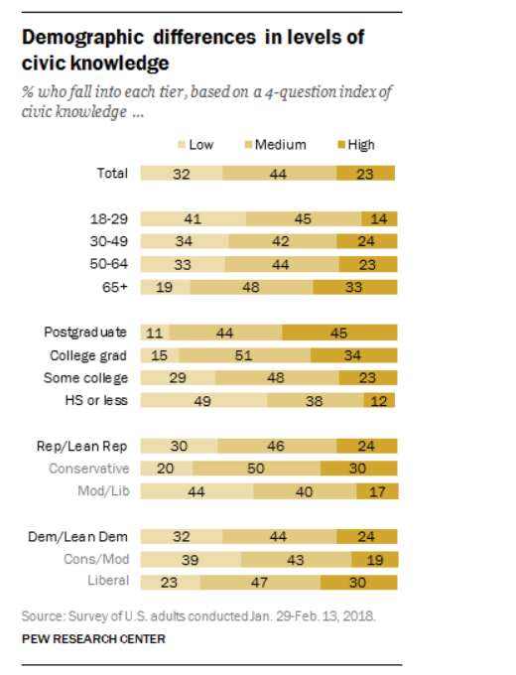
Theory Evidence
When surveyed by the Pew Research center, civic knowledge is low among college students compared to older generations.
The low average score on political knowledge could result in a higher variability of knowledge between STEM and non-STEM majors

Slide 8
Hypotheses
Students with humanities majors will exhibit more political knowledge
Why?
Humanities majors are more likely to be exposed to politics, American culture, or societal issues
Classes are centered around discussion, debate, and conversation starting questions
Business majors and most STEM majors will be less informed on voting procedures and more conservative leaning
Why?
These majors are less likely to have received formal education on topics surrounding political knowledge and voting procedures
Classes focus largely on science/math, leaving little room for discussions

Slide 9
Hypotheses(Significance Test)
Hypothesis 1: Race vs. Abortion
N: No statistically significant association between race and abortion.
A: A statistically significant association between race and abortion
Hypothesis 2: Political Knowledge vs Field
N: No statically significant association between STEM and non-STEM fields to political knowledge.
A: A statistically significant association between STEM and non-STEM fields to political knowledge.
Hypothesis 3: Political Party vs. Field
N: No statistically significant association between STEM and non-STEM fields to partisan identity.
A: A statistically significant association between STEM and non-STEM fields to partisan identity.

Slide 10
Methods
To isolate the variables, we used
Questions that focused on voter knowledge and equivalent voter laws in North Carolina.
Questions that isolated demographics in major and partisanship
Strengths/Weaknesses:
The voter knowledge questions were very baseline, all involving steps a voter would take and need to you (+)
The major question did not allow for ALL majors due to the quantity, so we had to regroup and isolate by STEM vs. non STEM (-)
Overall, these allowed us to still get a good understanding on the knowledge major classifications had on voting.

Slide 11
Methods
To Describe our survey sample we had 16 Democrats, 14 Independents and 1 Republican
Our race demographic was:
5 Black/African American
1 Asian
1 American Indian or Alaska Native
22 Caucasian
1 Caucasian and Black/African American
1 Other(category)
Hypothesis 1: Used Chi Sq test since race was nominal and abortion was ordinal
Hypothesis 2: Used ANOVA since field was nominal and Political Knowledge was interval
Hypothesis 3: Used Chi Sq test since Party Identification and field are both nominal

Slide 12
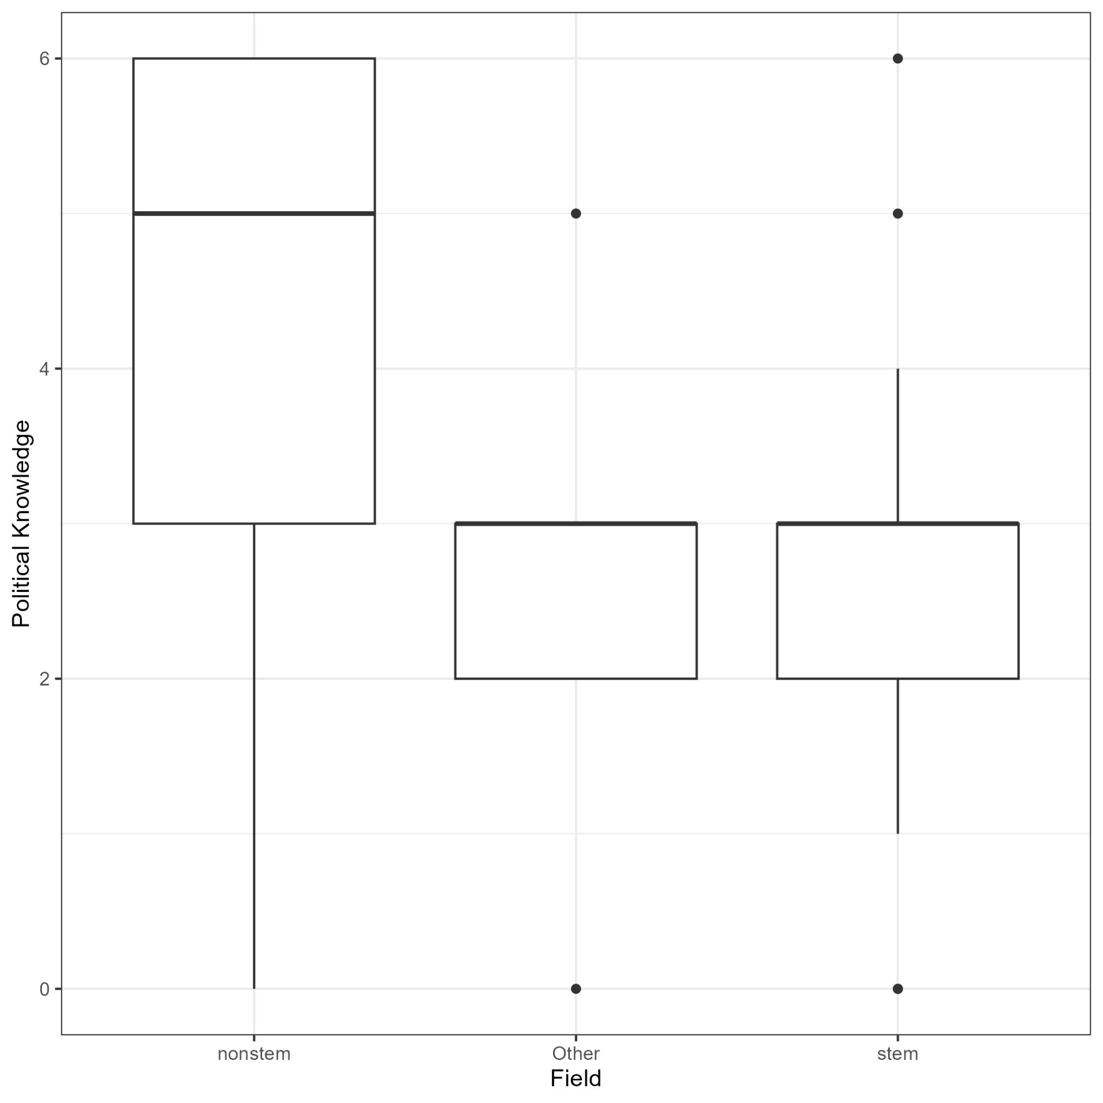
Findings and discussion: Hypothesis 2(political knowledge vs. Field)
ANOVA(P-value): .0486
Distribution marginally significant.
Cautiously reject null
TukeyHSD(P values for each combination) :
Other-Non stem: .1530
Stem-Non stem: .0513
Stem-Other: .99841

Slide 13
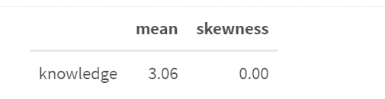
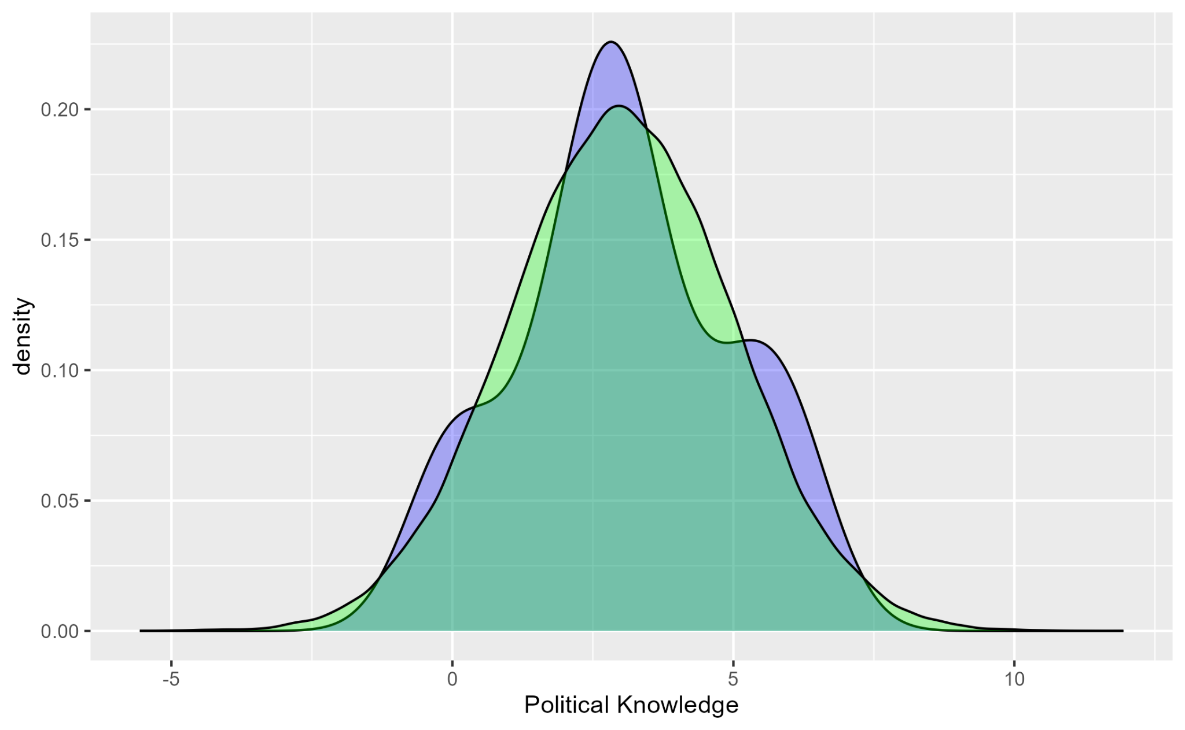
Findings and discussion: Hypothesis 2(political knowledge)
Very interesting
Pol. Know. is normally distributed with mean 3.(not common)
Blue(Pol.Know.)
Green(Normal with mean 3, std 2)

Slide 14
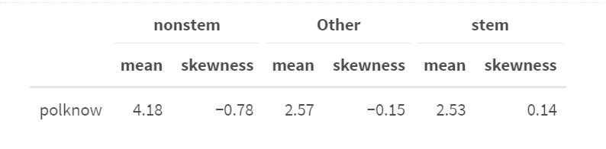
Findings and discussion: Hypothesis 2(political knowledge vs. Field)
Pol.Know. stats by Field
Positive skew means more values to left of mean
Negative skew means more values to right of mean
Close to indicating that for some reason non stem has more Pol.Know. then stem

Slide 15
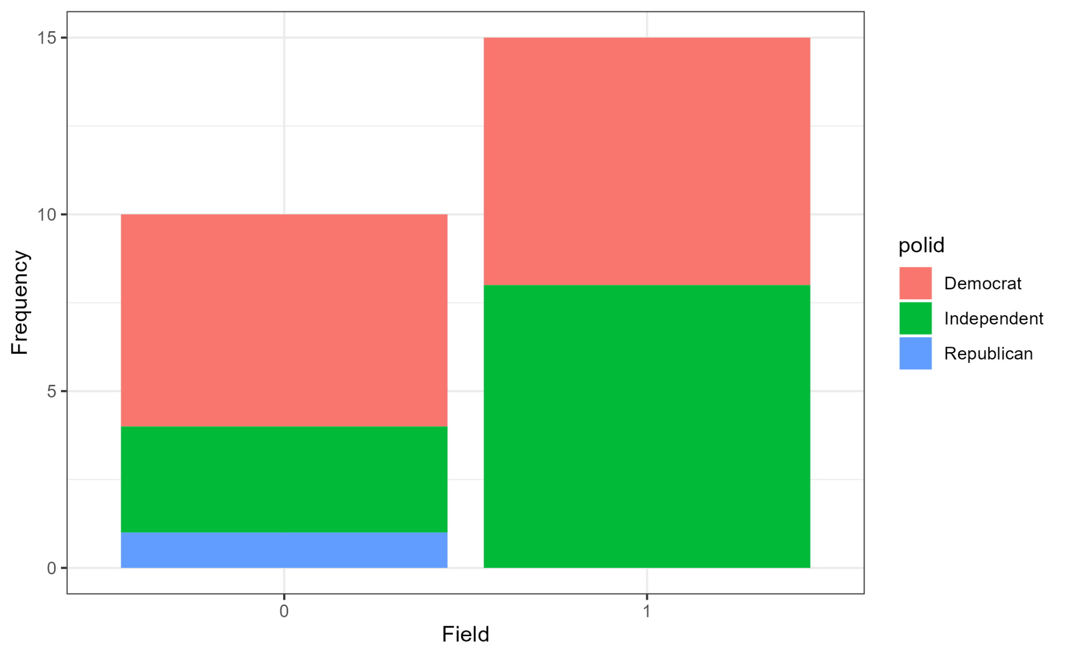
Findings and discussion: Hypothesis 3(Pol. ID vs. Field)
Chi sq test (p-value): .7789
Not Statistically significant (association most likely due to chance)
Fail to Reject Null
Cramer’s V value: .215
Moderately close to weak association
- No support because UNC could be good blend of stem and non stem

Slide 16
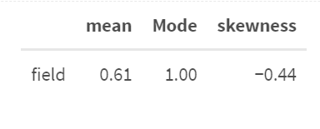
Findings and discussion: Hypothesis 3(Pol. ID vs. Field)
Stem showed up most in field
If field were a R.V. person would be stem with probability .61
Skew toward right(Stem) but not by great amount

Slide 17
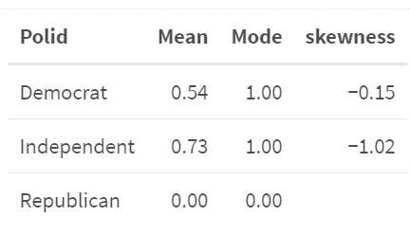
Findings and discussion: Hypothesis 3(Pol. ID vs. Field)
Stem showed up most in both parties
If field were a R.V. person that is democrat or independent could be stem with probability .54 and .73
Skew toward right(Stem)

Slide 18
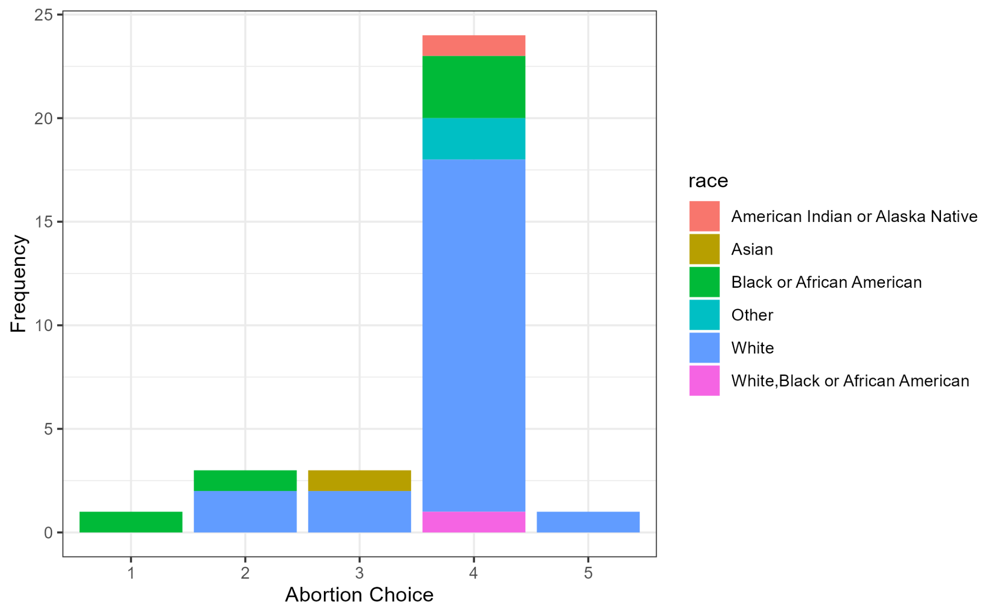
Findings and discussion: Hypothesis 1(Race vs Abortion)
Chi sq test (p-value): 1.194e-07
Statistically significant (association most likely not due to chance)
Reject Null
Cramer’s V value: .533
Showing that race and abortion have a strong association
People having common ideologies about this topic could be reason why we reject Null

Slide 19
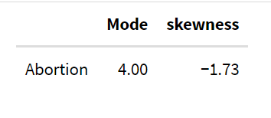
Findings and discussion: Hypothesis 1(Race vs Abortion)
Choice 4 was most popular answer choice
Skewed right so more answers of choices 4-5 then in 1-3

Slide 20
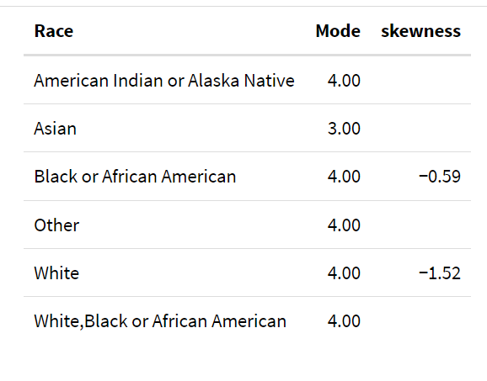
Findings and discussion: Hypothesis 1(Race vs Abortion)
-Popular choices by demographic
- Skewness by demographic

Slide 21
Conclusion
Non STEM majors scored slightly higher on political knowledge than STEM majors most likely because they have more courses relevant to the topic.
Non STEM and STEM majors do not show a significant difference in political party ID between each other.
Most surprising as previous data from the workforce and college majors indicate that STEM workers tend to be conservative.
Could be due to generational differences, perception of independents, or small sample size.

